Slide 1
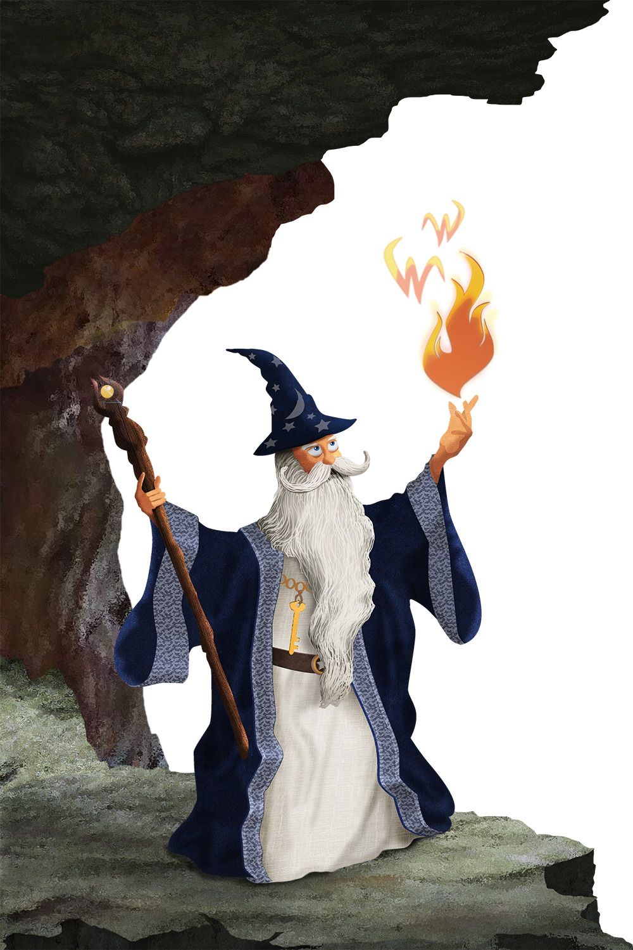

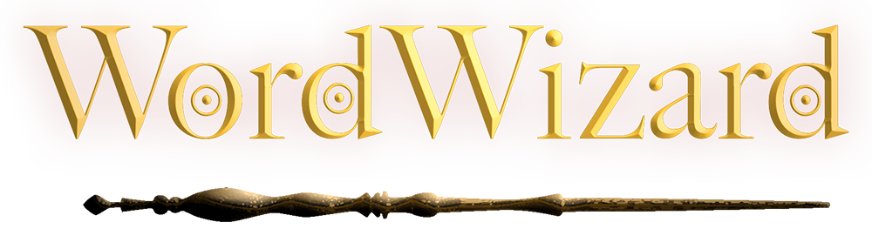

An Interactive Anagram Puzzle Game
A TEAM-WEST PRODUCTION
Developed for the Android Mobile Platform
Hailey Gibson
Jeremy Gallagher
Jon-Erik Prichard
Notes:
PRESENTER NOTES: WordWizard is a single-player, multi-faceted anagram word finder puzzle game. The game is designed and developed for play on mobile devices with the Android operating system.

Slide 2
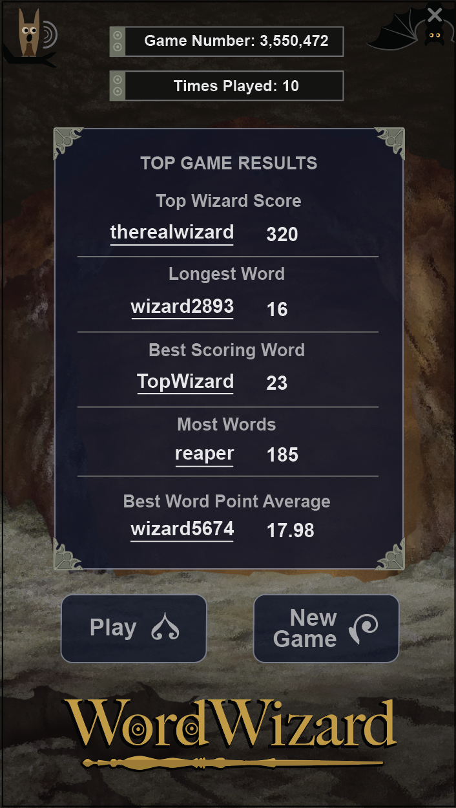
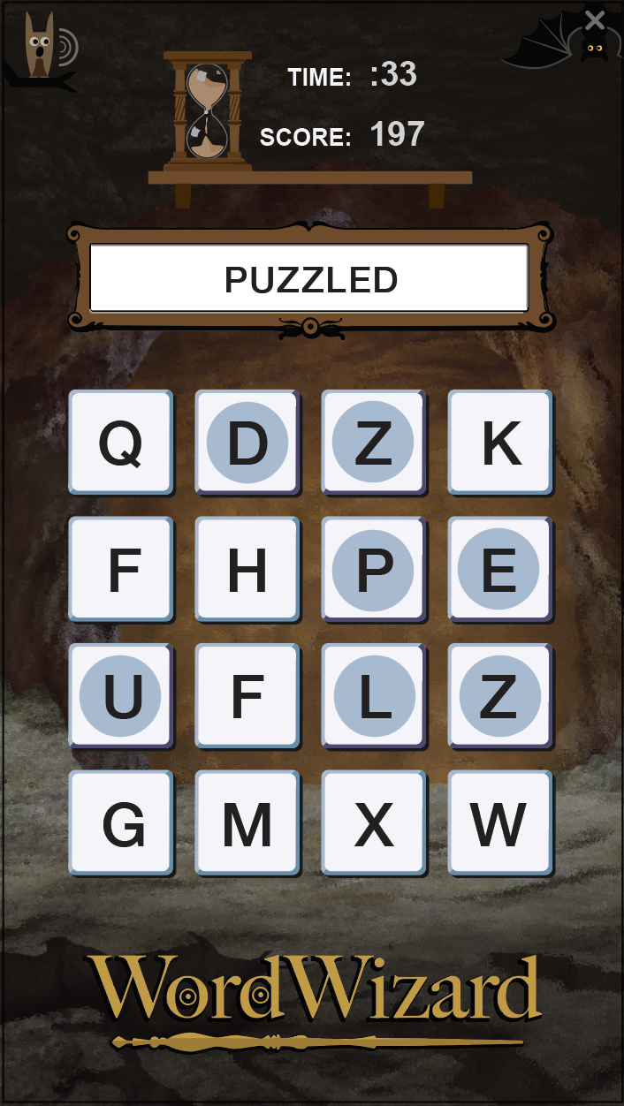
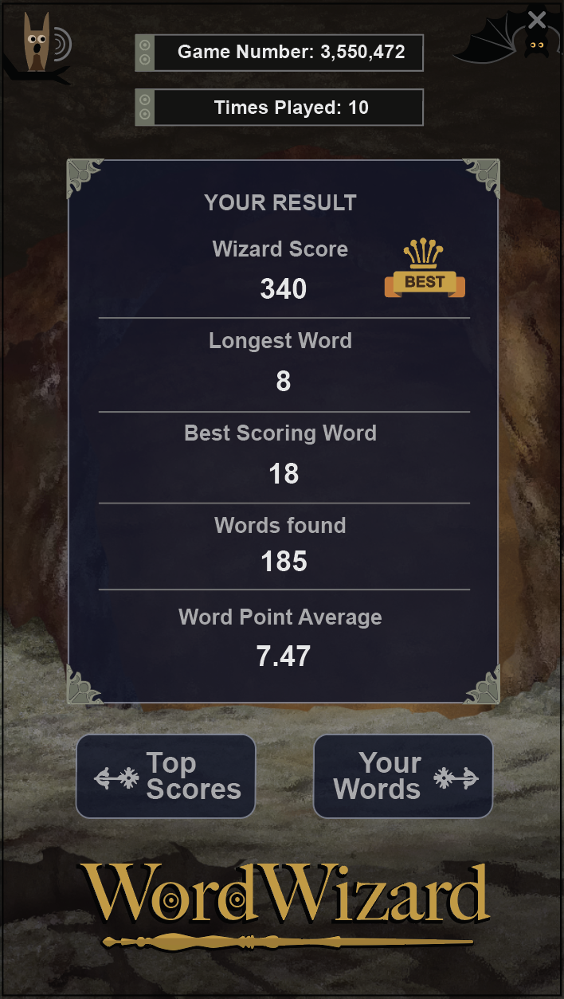
Selection
Play Space
Winning
The Game
Notes:
PRESENTER NOTES: When a player enters the WordWizard interface, a previous played game is displayed. Results from the top performances of the game provide players with information about the game. Here, the player can select to play the displayed game or select ’new game’ to find another one. Once the game starts, players are given three minutes to play three grids. Sixteen letters randomly display on the grid as players select from the letters to create words and build a score. After each minute the letters will scramble while the player continues, with a new set of letters from which to build words. Once the three minutes are expired the results of the player’s performance are displayed, with top-scores for the game receiving ‘best of game’ badges. Now the player can toggle between the words selected in the game and the previous high scores for comparison.

Slide 3
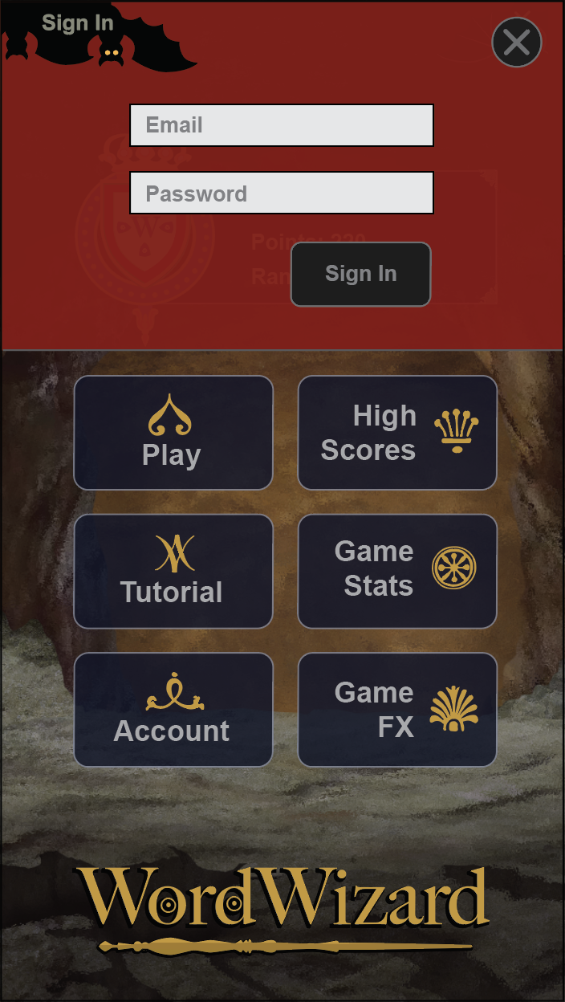
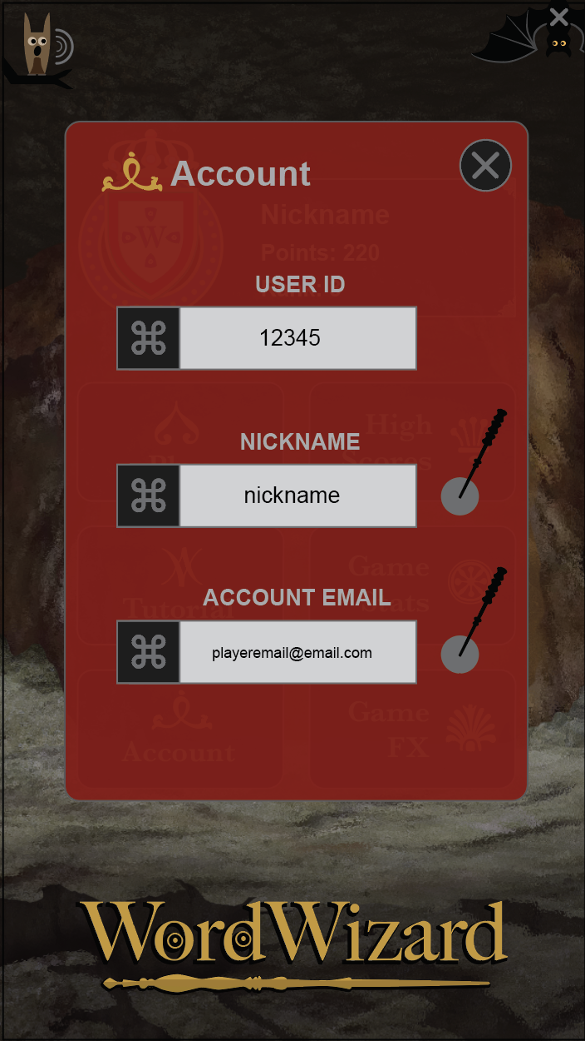
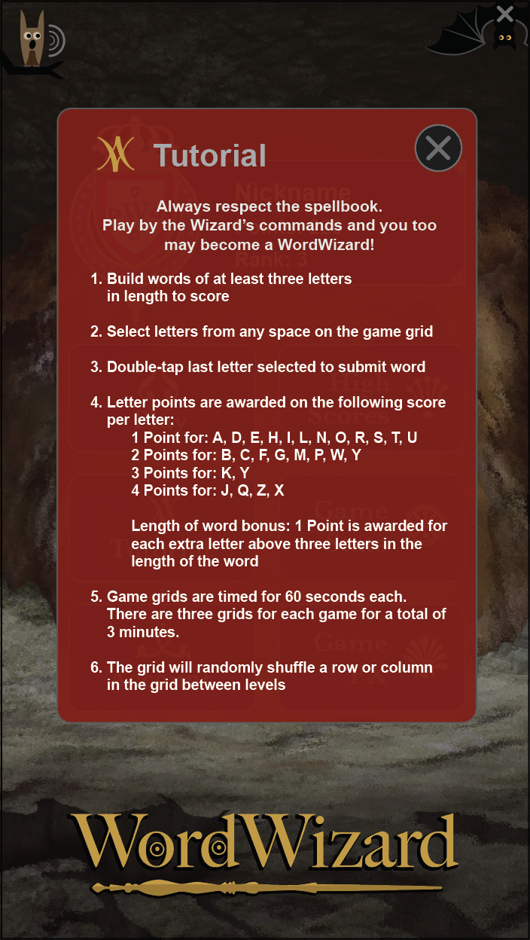
Simple Forms
Account Editing
Clear Rules
Consistency
Notes:
PRESENTER NOTES: WordWizard is designed for easy access and use. Its sign-up and sign-in forms and processes are simple and concise, with little information necessary to get started. Players can edit nickname and email information on their account, without the need to set up a different account if such information changes. This makes it easy to keep scores and records compiled by the Wizard players. The WordWizard rules and format are clear and consice, making it easy to play the game and know how to build up higher scores and become a true Wizard in the WordWizarding World.

Slide 4
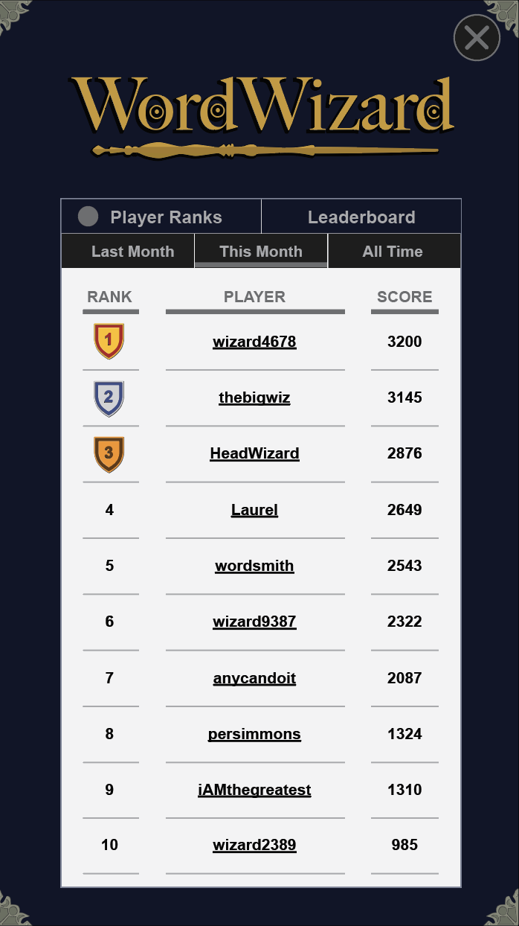
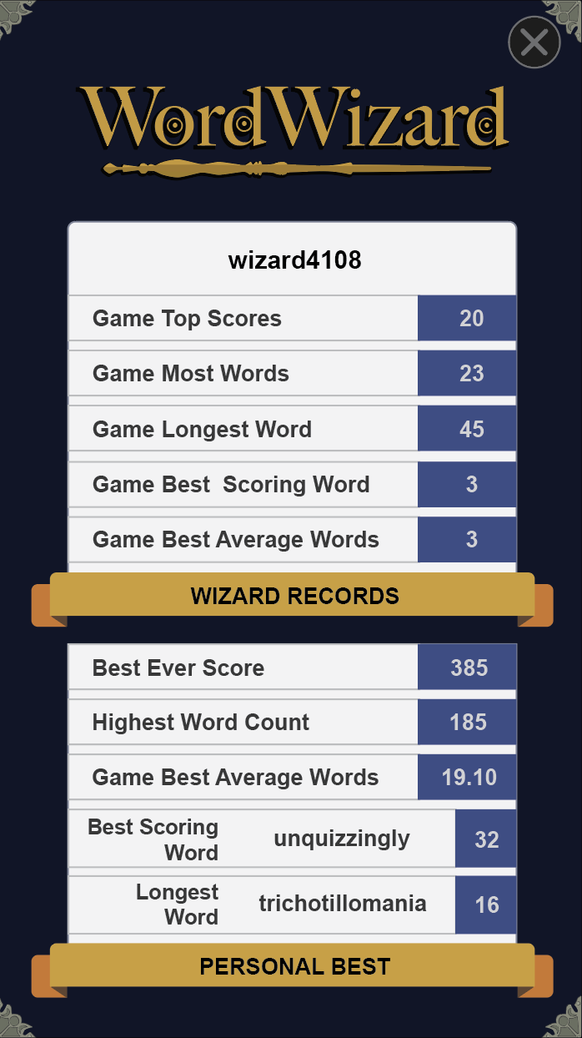
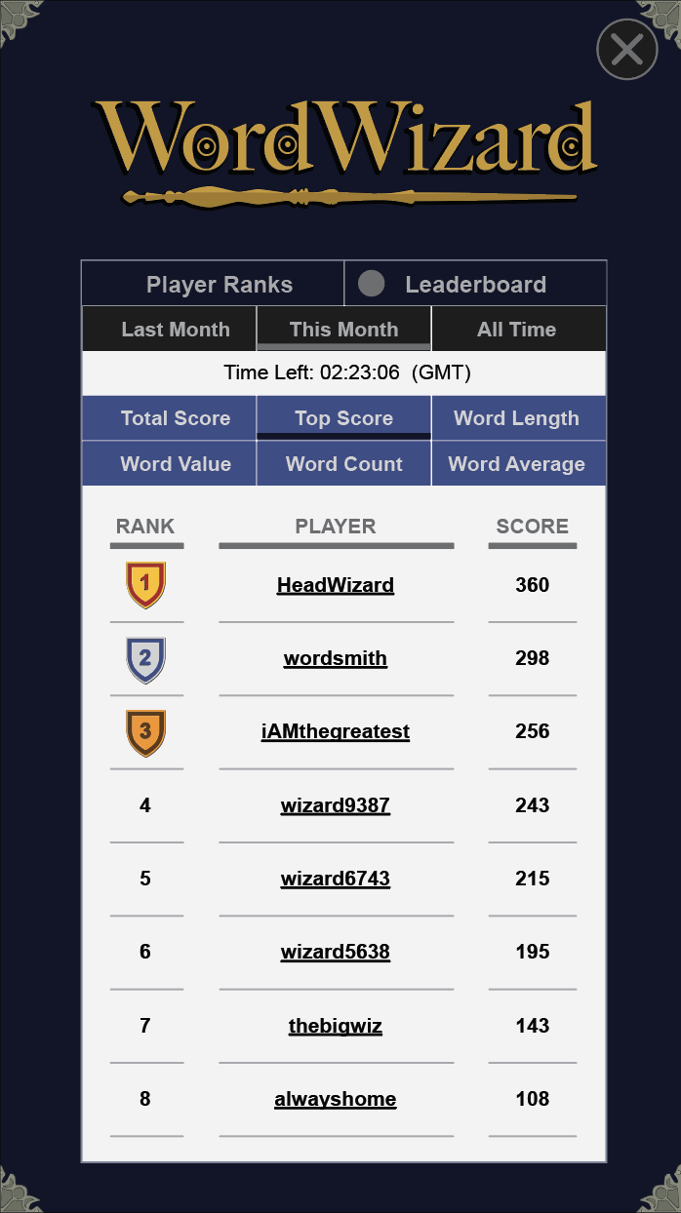
Player Ranks
Player Records
Player Leaderboard
Competition
Notes:
PRESENTER NOTES: Wizards can compete with other players for top honors. Players are ranked on a monthly basis and all monthly scores are compiled into an ‘all-time’ ranking. A Wizard’s individual records are also compiled and saved, with the number of top scores in each scoring category the Wizard has achieved in a WordWizarding career. The ‘player leaderboard’ keeps track of Wizard performance for each day, providing an instant ranking for each category. The categories include the top Total Score for the day, the top Game Score, top Word Length, top Word Value, top Word Count in a game and top Word Score Average for a game.

Slide 5
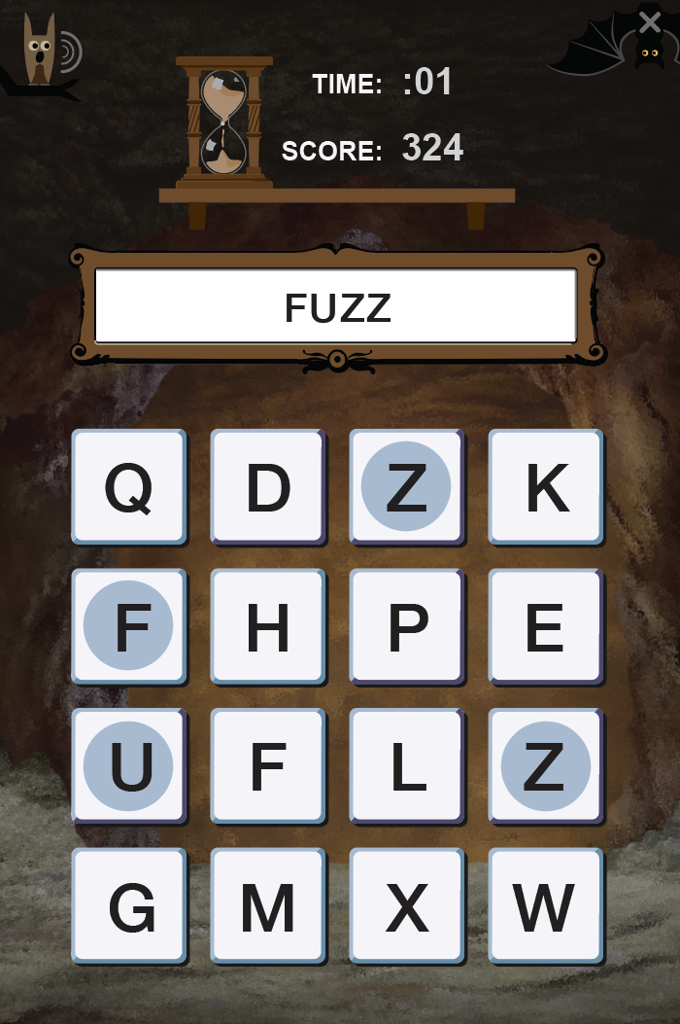
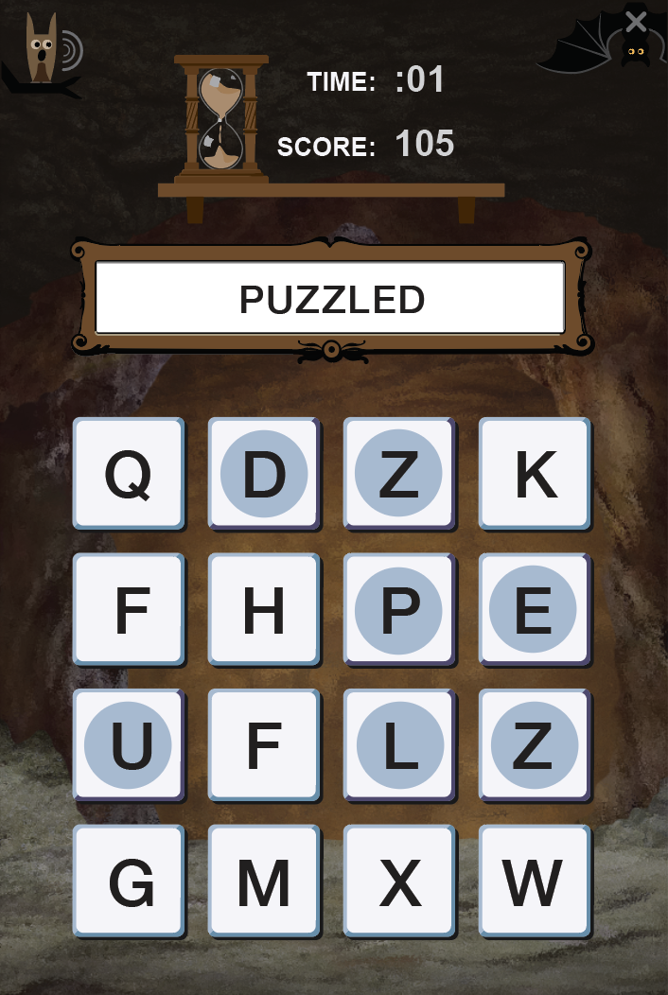
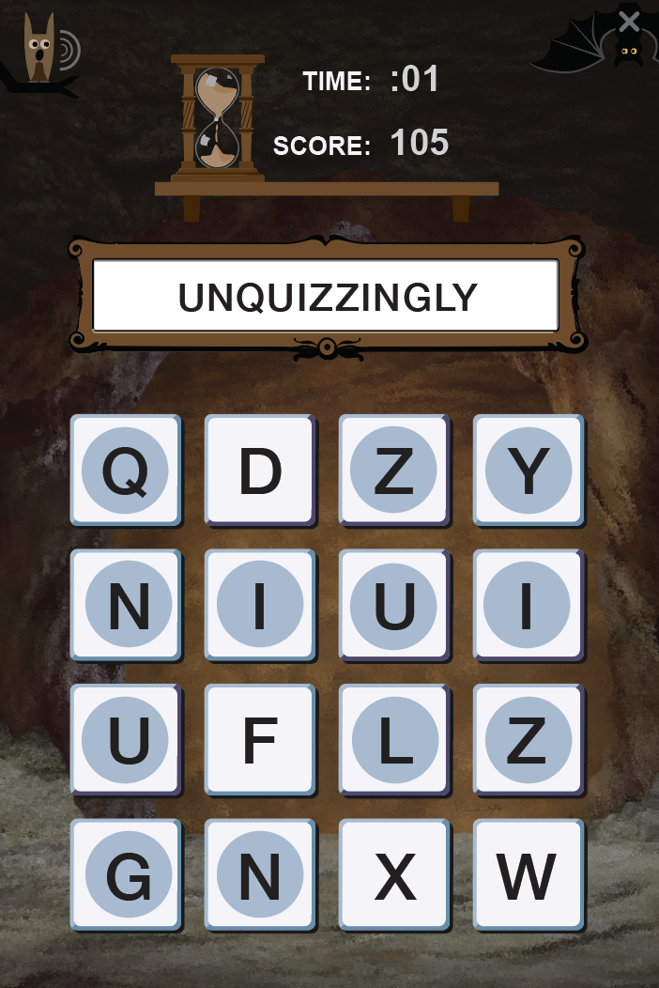
Play for Speed
Highest Average
Biggest and Longest
Most Words
Highest Game Score
Highest Average Word Score (Min. 20 Words)
Longest Word
Highest Scoring Word
Wizard Strategy
Notes:
PRESENTER NOTES: Top Word Wizards can play the game to achieve performance with different strategies. One strategy is the ‘speed game’ where Wizards rack up as many words as possible to build up the Most Words and Highest Game Score for each game. A second Wizard strategy is to select only long and high scoring words to achieve the highest average word score for the game. A third strategy is to find very long and very high scoring words to score top WordWizarding honors in the Longest Word and Highest Scoring Word categories.

Slide 6
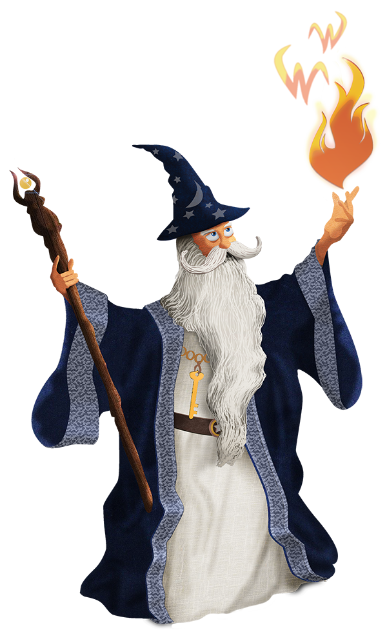
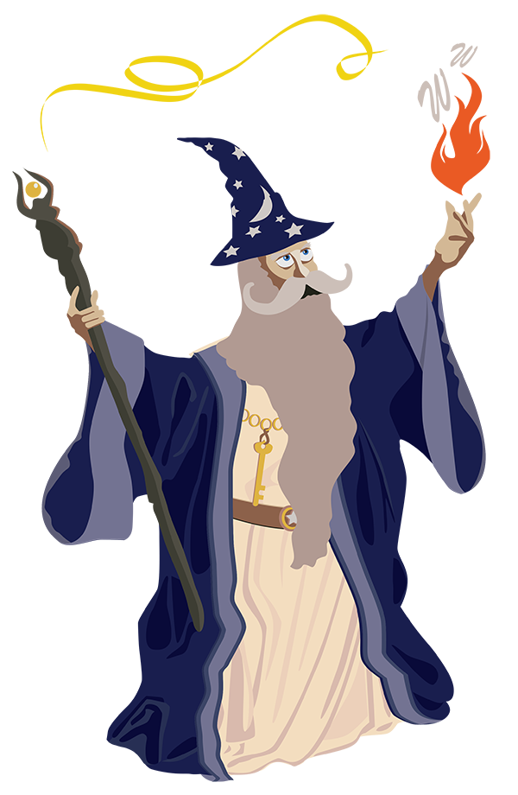
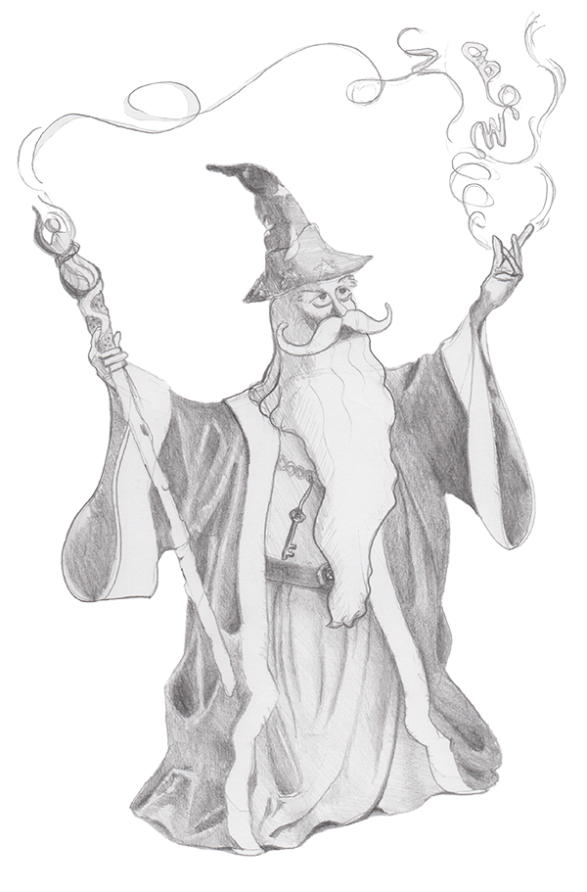
Original Concepts
Refined Definition
Finished Product
Development
Notes:
PRESENTER NOTES: WordWizard is developed from scratch as a unique game with its own set of rules and game atmosphere. The game was developed in an Agile software development environment starting with concept origination and writing user stories that turned into refined definitions of game play and flow. Finally, a finished product was produced where player value and fun is the focus.

Slide 7



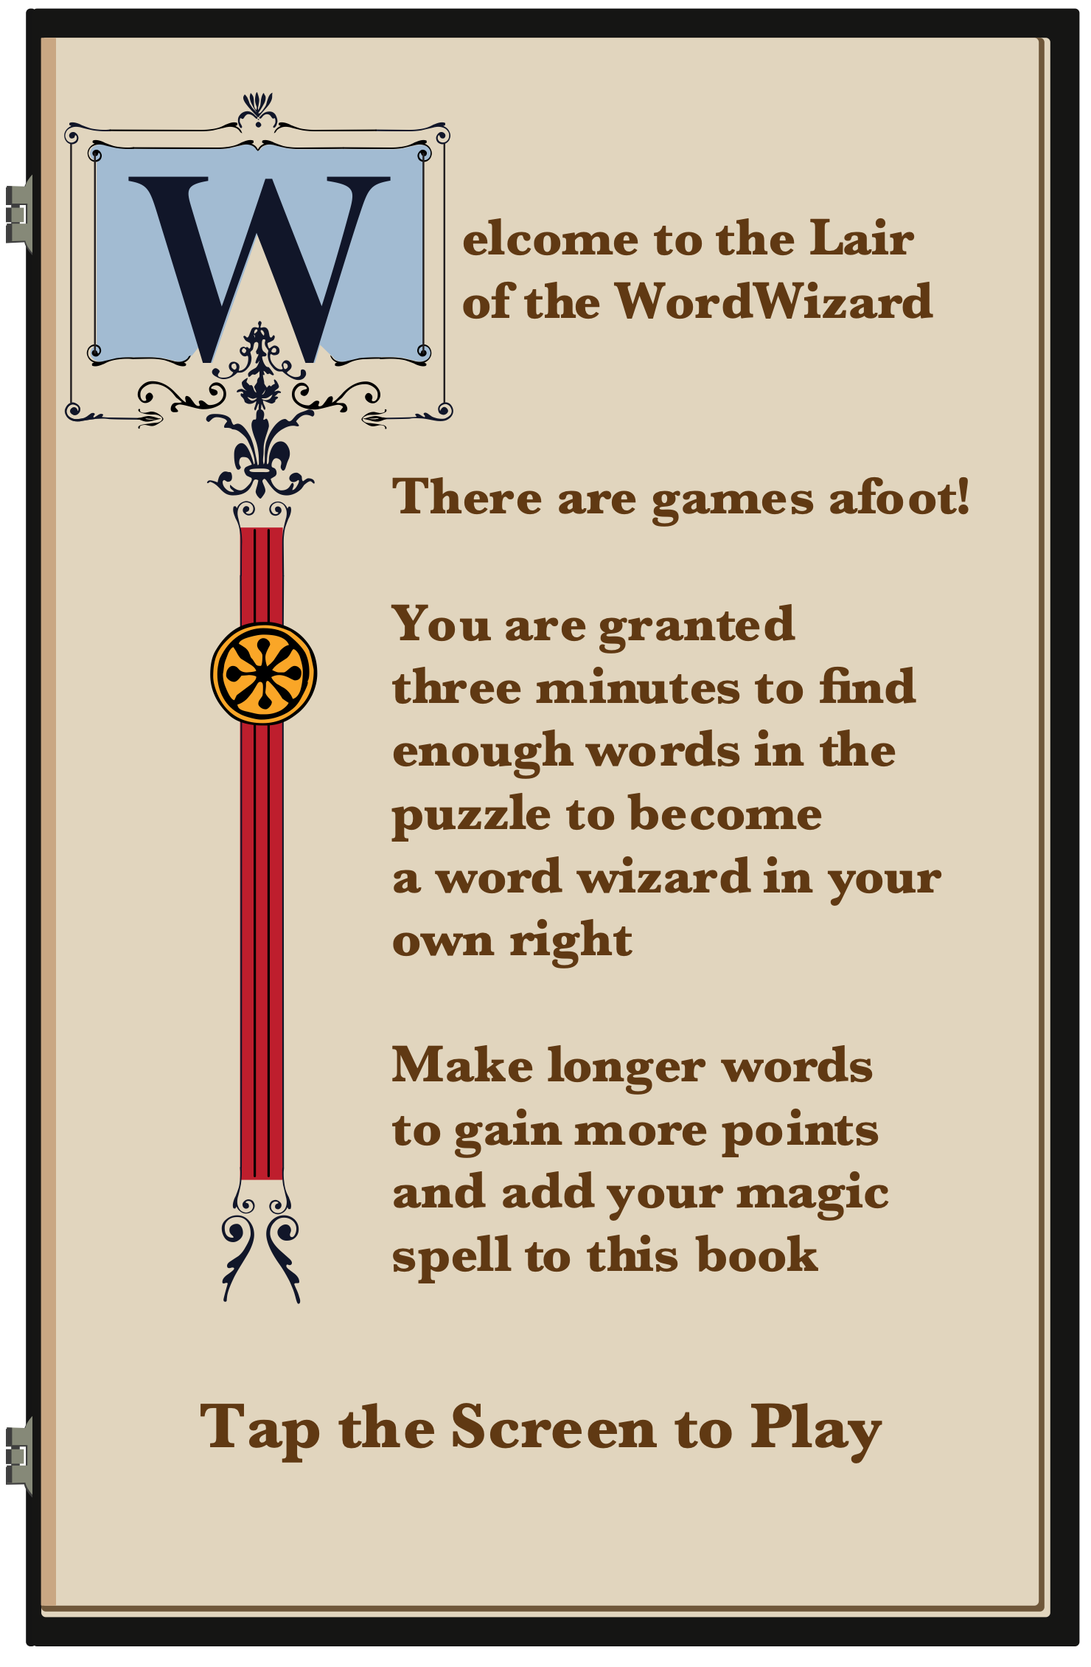
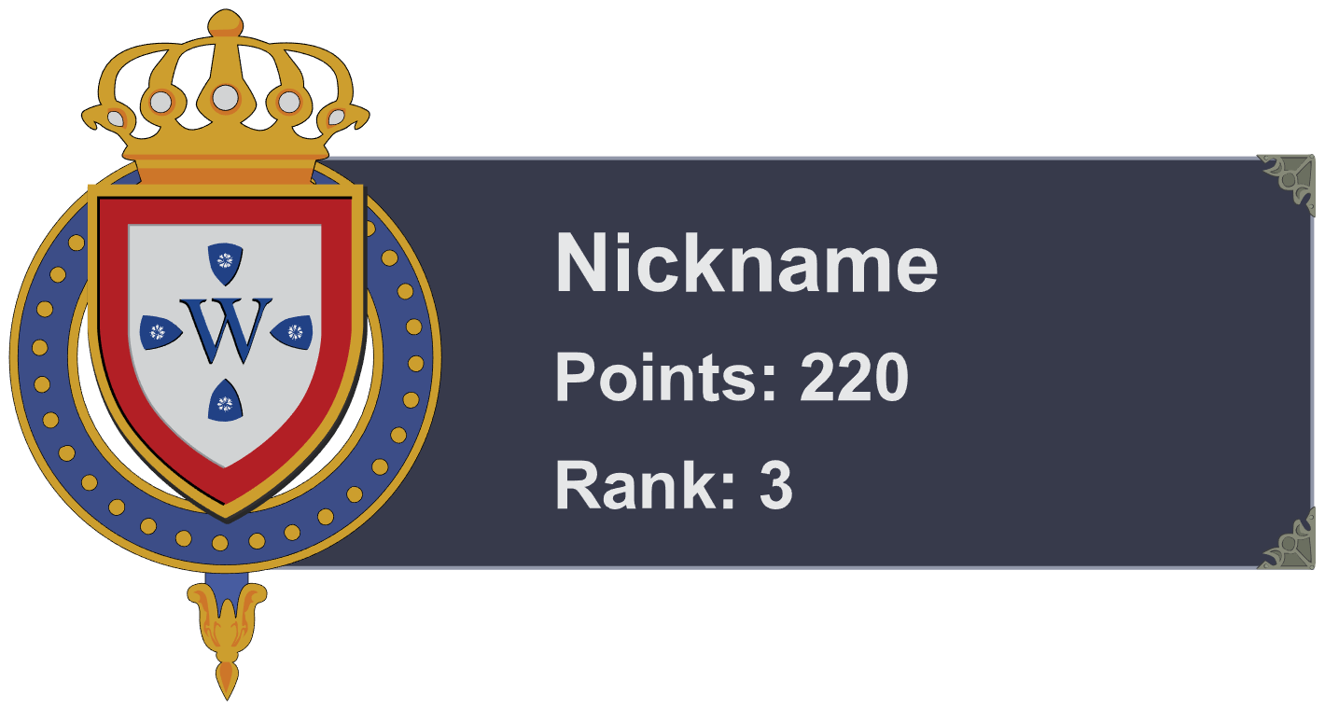
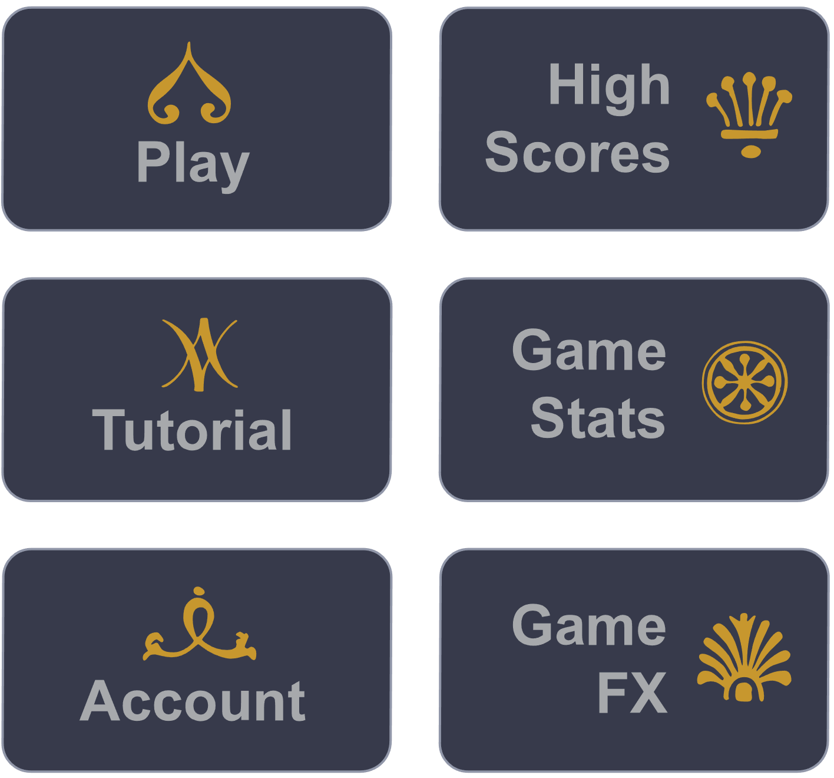
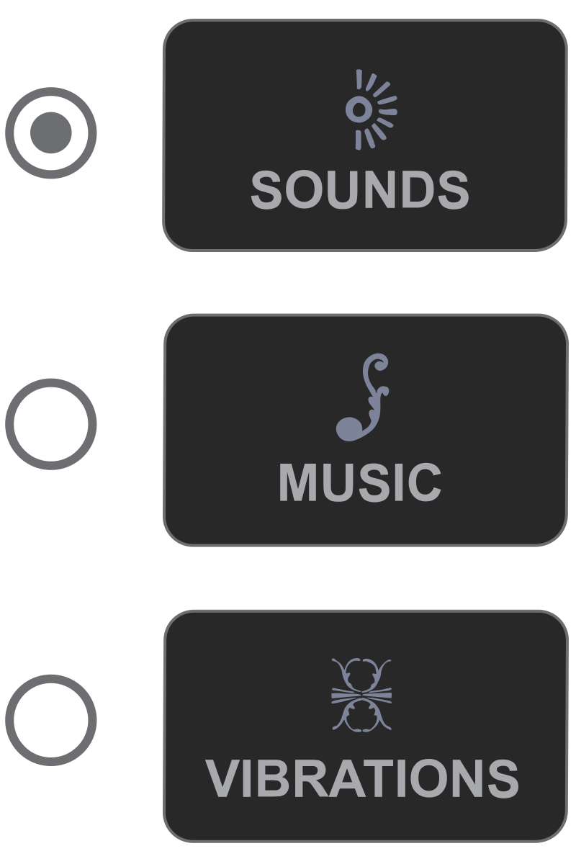

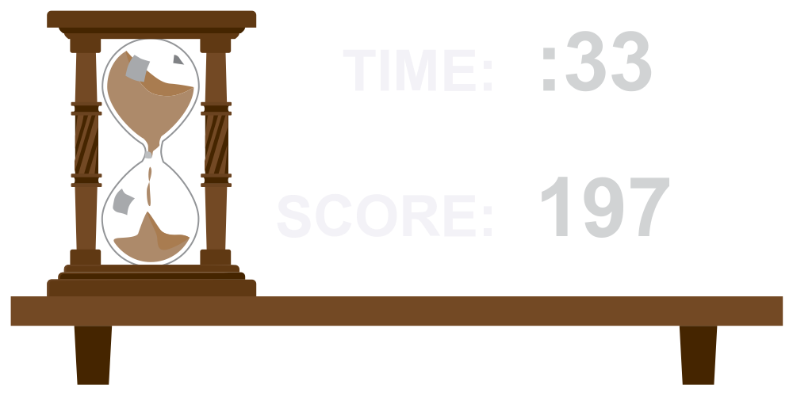


Presenting a Magical Realm, Where every Board and Button Tells a Story
Style & Theme
Notes:
PRESENTER NOTES: WordWizard is designed with an enchanted wizard theme reminiscent of the magical realm of Merlin the Master Wizard of all time. Each button, icon, background and function helps bring players into the WordWizarding World.

Slide 8
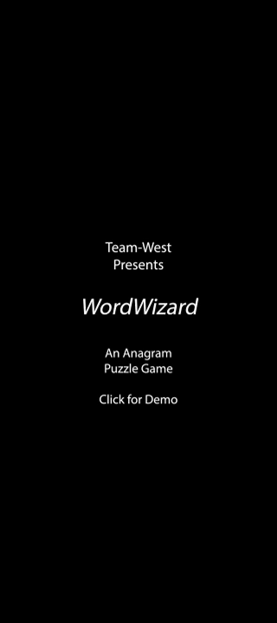
Try WordWizard Now – It’s Absolutely Free!
In Action
Illustration Atulhost.com
Notes:
PRESENTER NOTES: Try WordWizard, its absolutely free!

Slide 9






Team-West
Hailey Gibson
Jeremy Gallagher
Jon-Erik Prichard
Master Wizard
Builder Wizard
Creative Wizard
Product Owner
Business Logic Creation
Database Design, Implementation
Resource Research and Acquisition
Deployment Configuration
Technical Development Lead
Android Studio Expertise
Java and PHP Programming
Function Design, Integration
Graphics Integration
Scrum Master
Product Designer, Conceptual Lead
Storyboard Creator and Writer
Project Documentation Management
Graphic Artist
Credits

